Slide 1


Slide 2
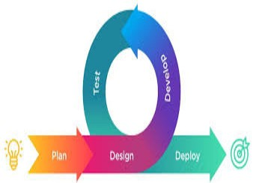
AGILE APPROACH
What is Agile?
Agile is the ability to create and respond to change. Agile is an iterative approach to project management and software development, that helps to improved quality and speed to market, and boosted the motivation and productivity of IT teams.
Related
Video:https://www.youtube.com/watch?v=Z9QbYZh1YXY

Slide 3

FEATURES IN AGILE APPROACH
Communication and Collaborations-frequent and close cooperation between software team and end users.
Customer Satisfaction-meet user requirements even at end of projects
User Feedback: With agile, teams can provide the best user experience for end-users by delivering project early for feedback from users.
Scrum meetings help in eliminating issues: By following the agile methodology, teams will have daily meetings and constant discussions on the project.
Reduces the overall Project cost: In agile methodology, software testing tools and resources are centralized and this helps in improving resource utilization and also reduces the overall cost in maintaining and setting up the agile project.

Slide 4
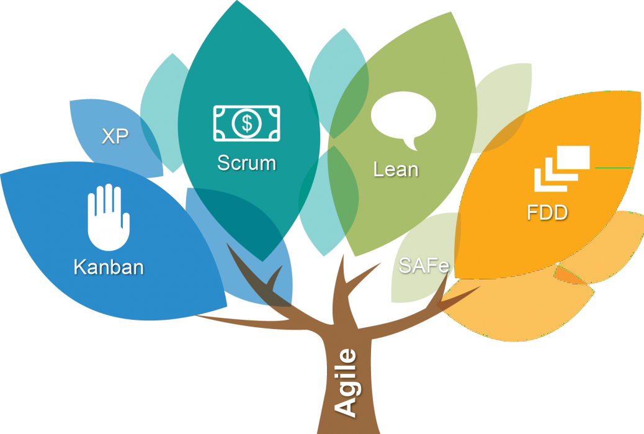
Agile Methodologies
Scrum: describes a set of meetings, tools, and roles that work in concert to help teams structure and manage their work
Kadan: is a visual system for managing work as it moves through a process.
Lean: aims to increase process efficiency and product quality by minimizing cost and waste.
Feature-Driven Development (FDD):allows
teams to update the project regularly and identify errors quickly.
Scaled Agile Framework (SAFe):designed to
help businesses continuously and more efficiently deliver value on a regular and predictable schedule.

Slide 5
Waterfall Approach to Software Development
Waterfall Methodology is referred to as a linear-sequential life cycle model. It is more formal and less flexible than Agile Approach.
It is very simple to understand and use. In a waterfall model, each phase must be completed before the next phase can begin and there is no overlapping in the phases.

Slide 6
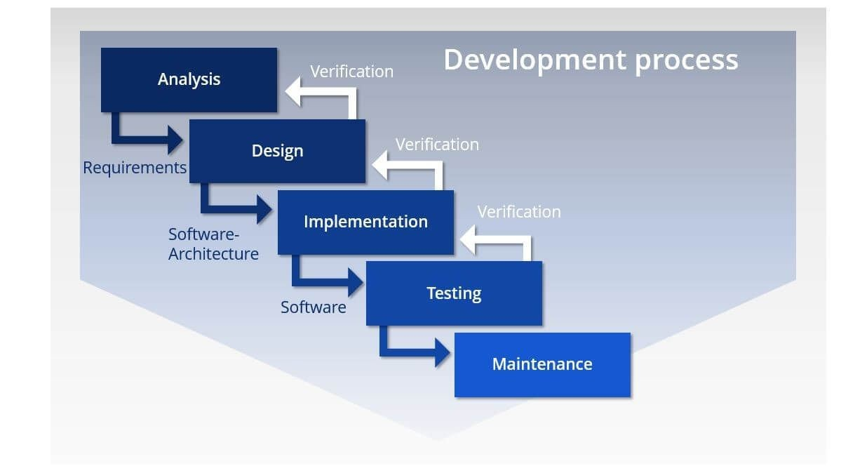
Waterfall Approach to Software Development

Slide 7

Waterfall Approach to Software Development
Advantages
Simple and easy to understand and use
Clearly defined stages.
Well understood milestones. Easy to arrange tasks.
Disadvantages
High amounts of risk and uncertainty.
Poor model for long and ongoing projects.
It is difficult to measure progress within stages. Cannot accommodate changing requirements.

Slide 8
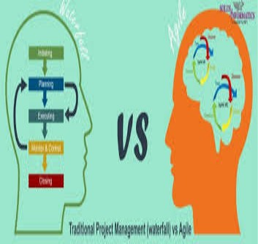
Waterfall Approach VS Agile Approach
Agile is an incremental and iterative approach; Waterfall is a linear and sequential approach.
Agile separates a project into sprints; Waterfall divides a project into phases.
Agile helps complete many small projects; Waterfall helps complete one single project.
Requirements are prepared everyday in Agile, while requirements are prepared once at the start in Waterfall.
Agile allows requirement changes at any time; Waterfall
avoids scope changes once the project starts.

Slide 9

Task
The COVID-19 pandemic has affected educational systems worldwide, leading to the closures of schools, universities and colleges. Your School is participating in a project to develop software and a website to allow teachers to support students during the lock- down.
Design a questionnaire to be used when collecting information from students.

Slide 10
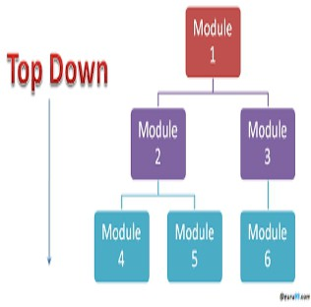
Top-Down Design
Each system is divided into several subsystems and components. Each of the subsystem is further divided into set of subsystems and components. This process of division facilitates in forming a system hierarchy structure.
Advantages:
It is strongly focus on requirements that helps to make a design responsive according to its requirements. Disadvantages:
Project and system boundaries tends to be application specification oriented. Thus it is more likely that advantages of component reuse will be missed.
The system is likely to miss, the benefits of a well- structured, simple architecture.

Slide 11
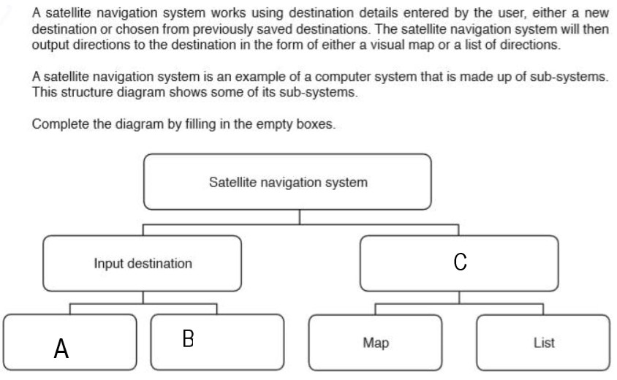
Task

Slide 12
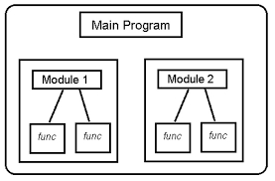
Modular Design
Refer as an approach used to design various products or applications – by breaking it down into separate or independent parts. These individual parts (for example, a laptop battery) can then be used for the same functionality in different systems or products.
Advantages:
Easy to customize products
Faster to market
Cost efficiency
Disadvantages
Design that is not fully as users specific.
Difficulty transporting and handling modules.

Slide 13
Thank you

